Slide 1
Layout Strategies
9

Slide 2
Strategic Importance of Layout Decisions
Develop an effective and efficient layout that will meet the firm’s competitive requirements

Slide 3
Layout Design Considerations
Higher utilization of space, equipment, and people
Improved flow of information, materials, or people
Improved employee morale and safer working conditions
Improved customer/client interaction
Flexibility

Slide 4
Good Layouts Consider
Material handling equipment
Capacity and space requirements
Environment and aesthetics
Flows of information
Cost of moving between various work areas

Slide 5
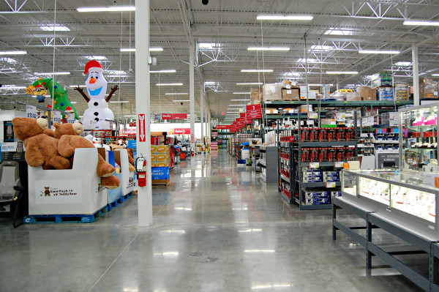
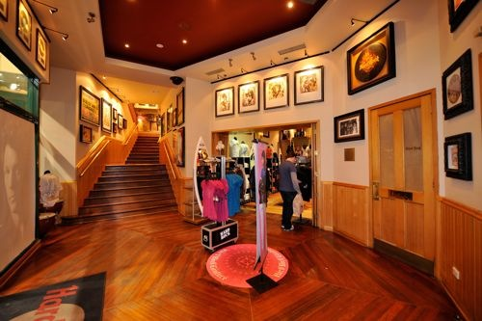
Layouts Enhancements
Ambient conditions
Background characteristics such as lighting, sound, smell, and temperature
Spatial layout and functionality
Customer circulation path planning, aisle characteristics, and product grouping
Signs, symbols, and artifacts
Characteristics of building design that carry social significance

Slide 6
Types of Layout
Office layout
Retail layout
Warehouse layout
Fixed-position layout
Process-oriented layout
Work-cell layout
Product-oriented layout

Slide 7
Real Examples
TABLE 9.1 | Layout Strategies
 |  | OBJECTIVES | EXAMPLES
Office |  | Locate workers requiring frequent contact close to one another | EB Depts – Where locate? NER – Open offices
Retail |  | Expose customer to high-margin items
Warehouse (storage) |  | Balance low-cost storage with low-cost material handling | Chem Safety – Reg issues MLS – Limited storage
Project (fixed position) |  | Move material to the limited storage areas around the site | Electric Boat – Sub construction
Job Shop (process oriented) |  | Manage varied material flow for each product | EB QP – Assembly areas Fender – Guitars
Work Cell (product families) |  | Identify a product family, build teams, cross-train team members | F&O – Separate by reg type Food Prod – Allergens
Repetitive/ Continuous (product oriented) |  | Equalize the task time at each workstation | Gorton’s – Production line Colfor – Production area NECCO – ? Min handling

Slide 8
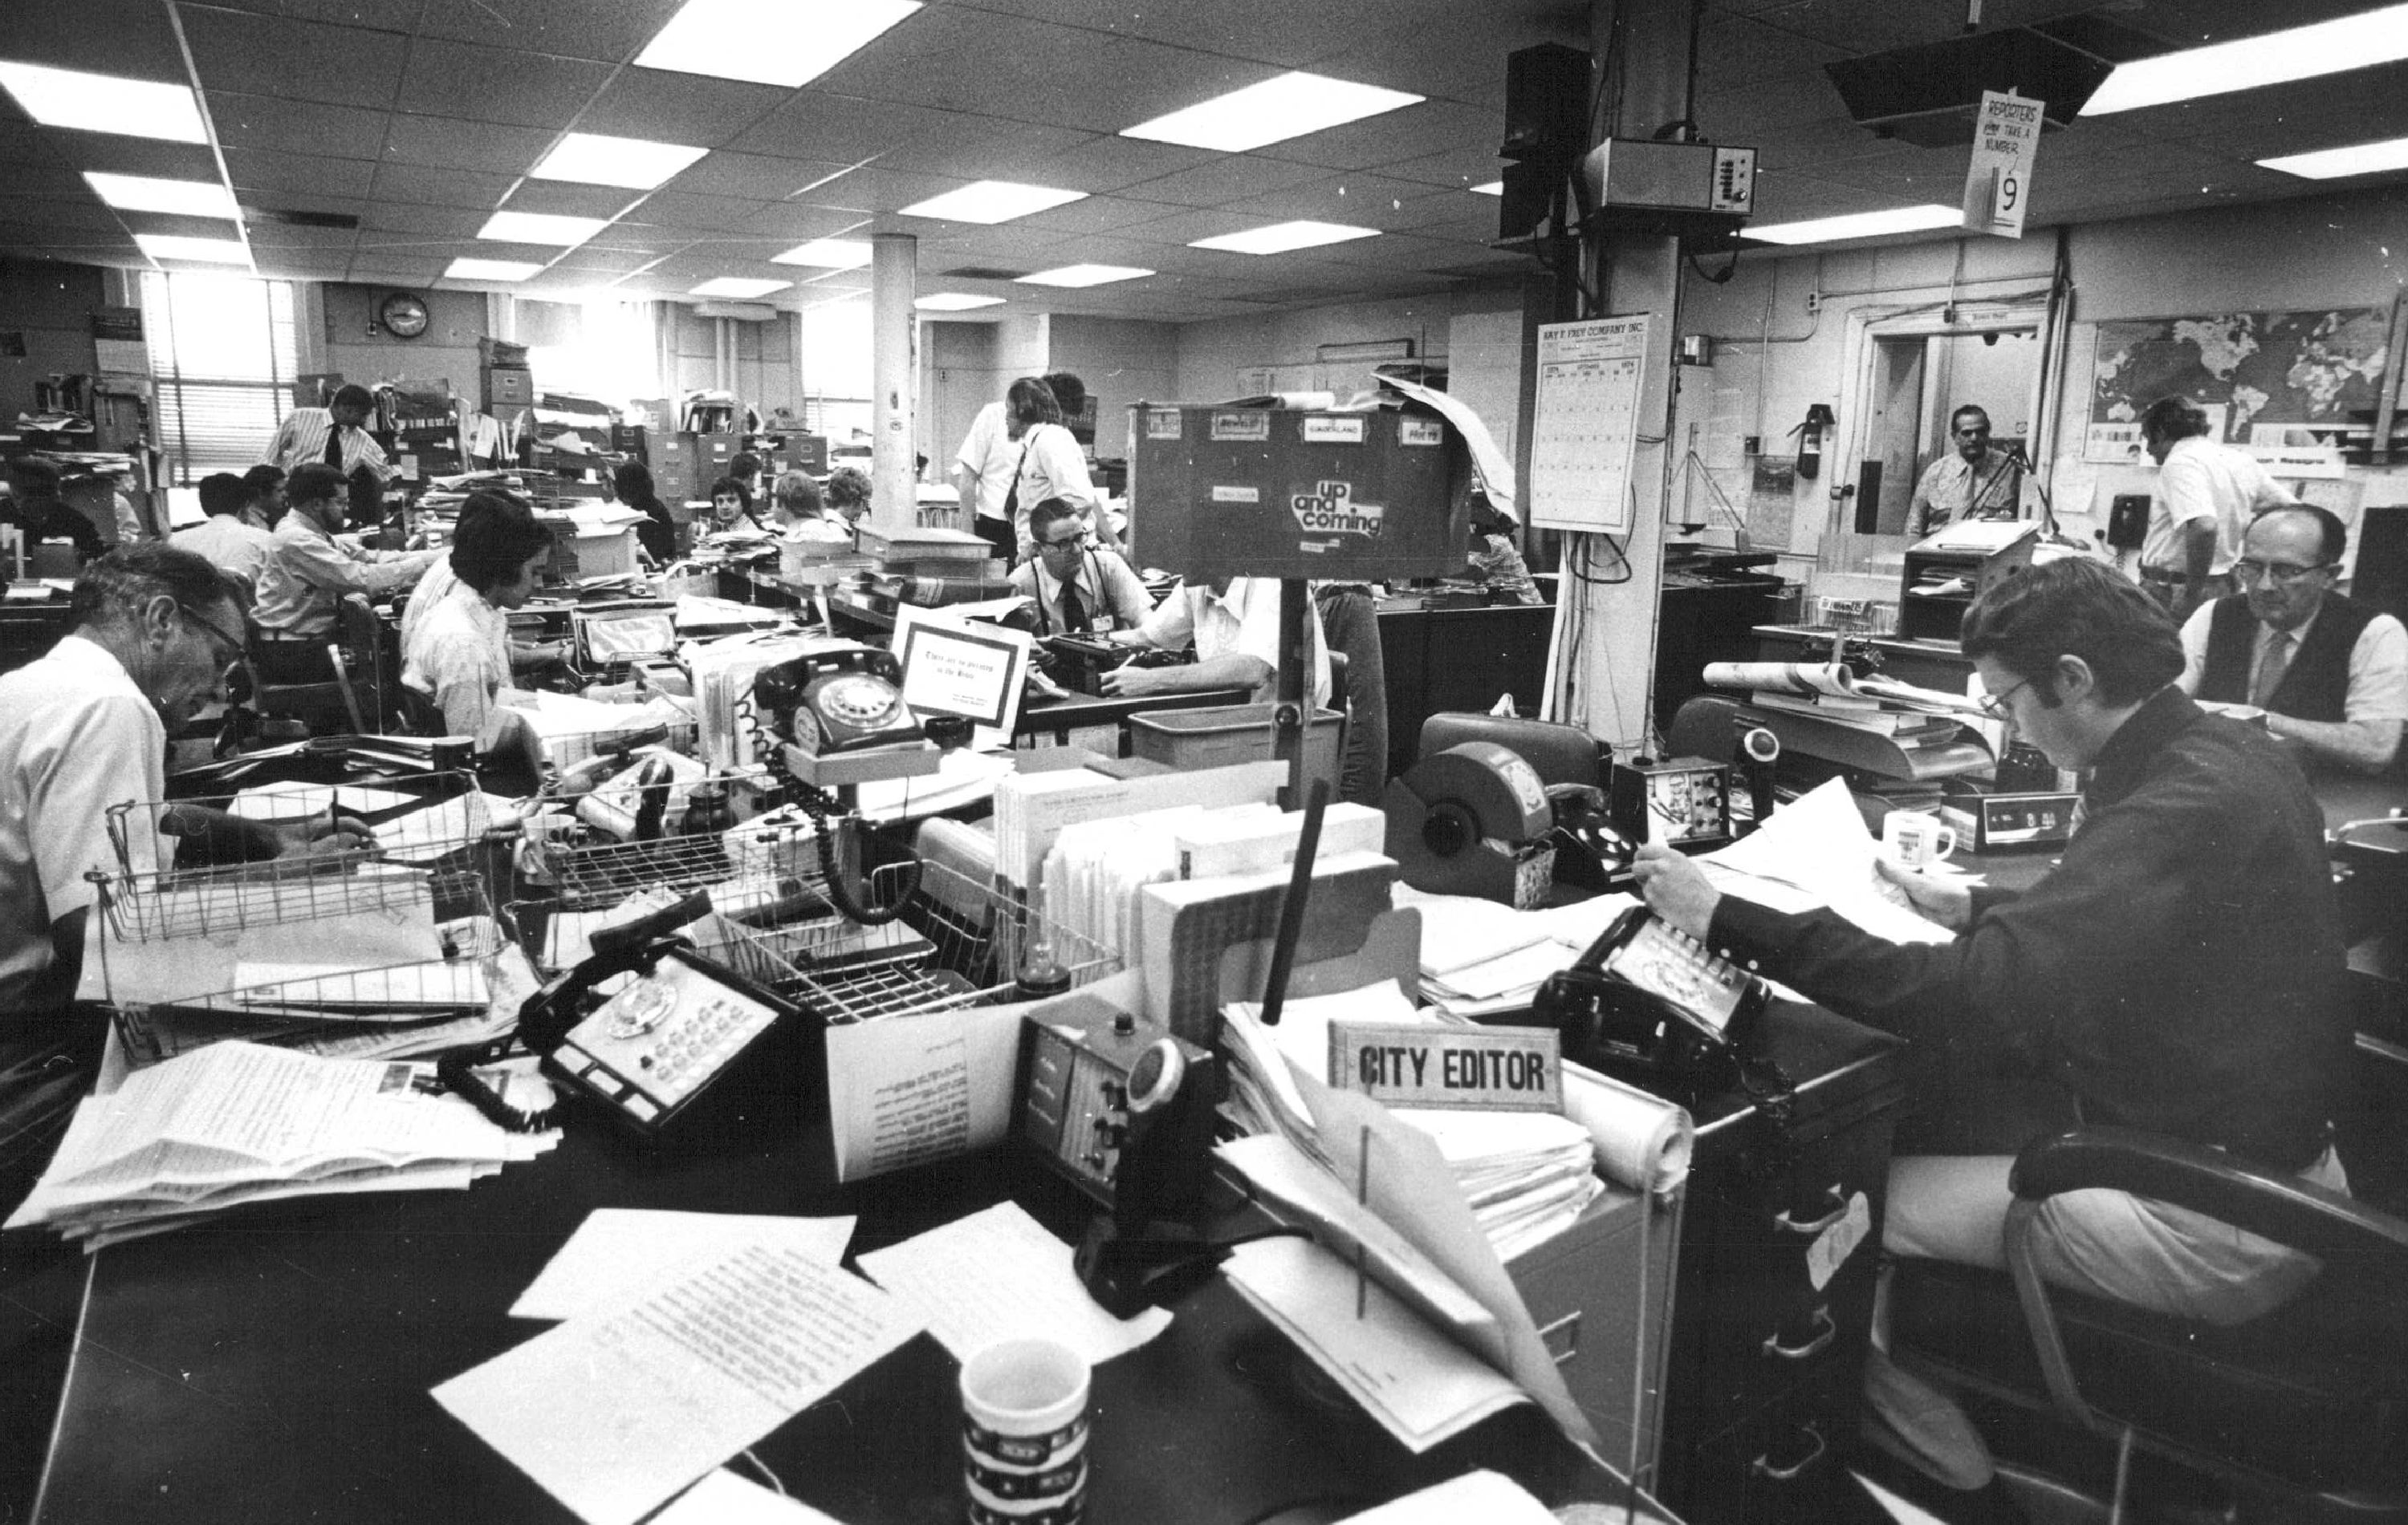
Office – Open Desks

Slide 9
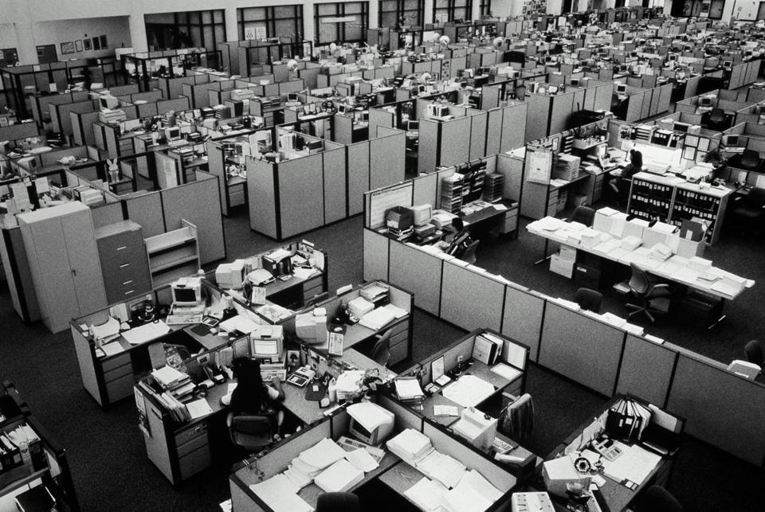
Office – Traditional Cubicle

Slide 10

Office – Modern Cubicle

Slide 11
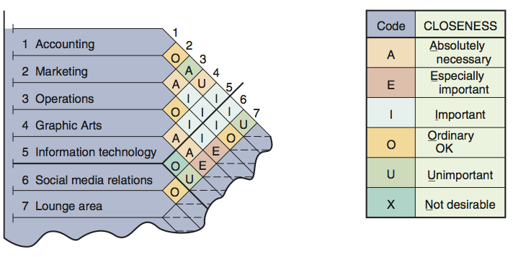
Relationship Chart
Figure 9.1

Slide 12
Relationship Diagramming Example – Survey Results
Area | Code
Production to Offices | O
Production to Stockroom | A
Production to Ship&Rece | I
Production to Locker room | E
Production to Toolroom | A
Offices to Stockroom | U
Offices to Ship&Rece | O
Area | Code
Offices to Locker room | X
Offices to Toolroom | U
Stockroom to Ship&Rece | A
Stockroom to Locker room | U
Stockroom to Toolroom | O
Ship&Rece to Locker room | U
Ship&Rece to Toolroom | O
Locker room to Toolroom | O
A - Absolutely necessary
E - Especially important
I - Important
O - Okay
U - Unimportant
X - Undesirable

Slide 13
Relationship Diagramming Example
A - Absolutely necessary
E - Especially important
I - Important
O - Okay
U - Unimportant
X - Undesirable
Production
Offices
Stockroom
Shipping and receiving
Locker room
Toolroom
Area | Code
Offices to Locker room | X
How important is having the locker room and offices adjacent to each other?

Slide 14
Relationship Diagramming Example
A - Absolutely necessary
E - Especially important
I - Important
O - Okay
U - Unimportant
X - Undesirable
Production
Offices
Stockroom
X
Shipping and receiving
Locker room
Toolroom
Area | Code
Offices to Locker room | X
How important is having the locker room and offices adjacent to each other?

Slide 15
Relationship Diagramming Example
A - Absolutely necessary
E - Especially important
I - Important
O - Okay
U - Unimportant
X - Undesirable
Production
Offices
Stockroom
X
Shipping and receiving
Locker room
Toolroom
Area | Code
Stockroom to Toolroom | O
How important is having the stockroom and toolroom adjacent to each other?

Slide 16
Relationship Diagramming Example
A - Absolutely necessary
E - Especially important
I - Important
O - Okay
U - Unimportant
X - Undesirable
Production
Offices
A
A
A
A
A
Stockroom
X
E
E
E
E
E
Shipping and receiving
I
I
I
I
I
O
O
O
O
O
Locker room
U
U
U
U
U
Toolroom
X
X
X
X
X

Slide 17
Relationship Diagramming Example
A - Absolutely necessary
E - Especially important
I - Important
O - Okay
U - Unimportant
X - Undesirable
Production
O
Offices
A
U
I
Stockroom
O
E
A
X
A
Shipping and receiving
U
U
U
O
Locker room
O
O
Toolroom

Slide 18
Retail Layout
Objective is to maximize profitability per square foot of floor space
Sales and profitability vary directly with customer exposure

Slide 19
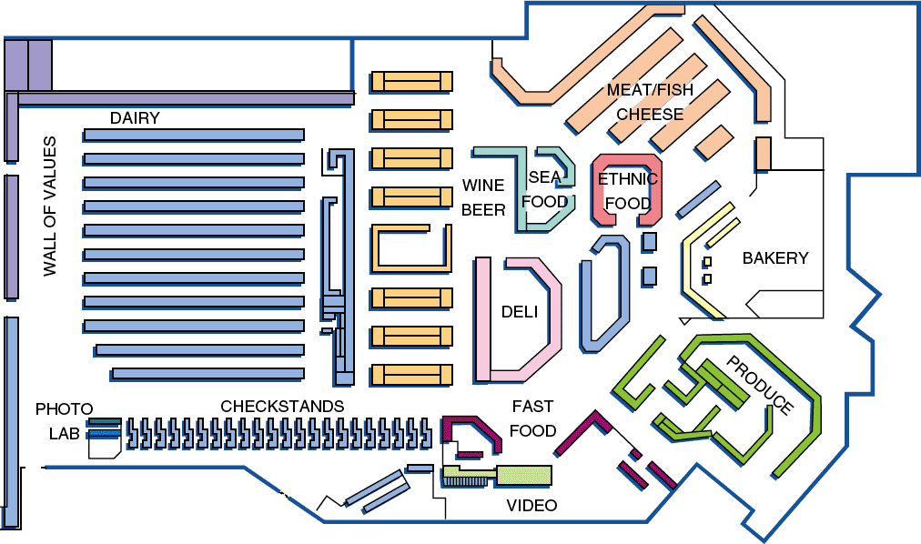
Store Layout
Figure 9.2

Slide 20
Warehouse and Storage Layouts
Objective
Find the optimum trade-offs between handling costs and costs associated with warehouse space
Maximize the total “cube” of the warehouse
Use its full volume while maintaining low material handling costs

Slide 21
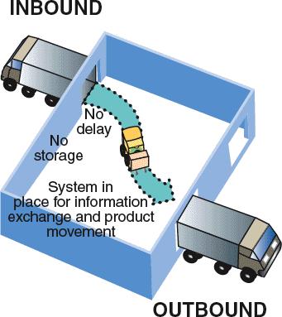
Cross-Docking
Materials are moved directly from receiving to shipping and are not placed in storage in the warehouse
Requires tight scheduling and accurate shipments, bar code or RFID identification used for advanced shipment notification as materials are unloaded

Slide 22
Fixed-Position Layout
Product remains in one place
Materials come to it
Extreme example is a house
Workers and equipment come to site
Complicating factors
Limited space at site
Different materials required at different stages of the project
Volume of materials needed is dynamic

Slide 23
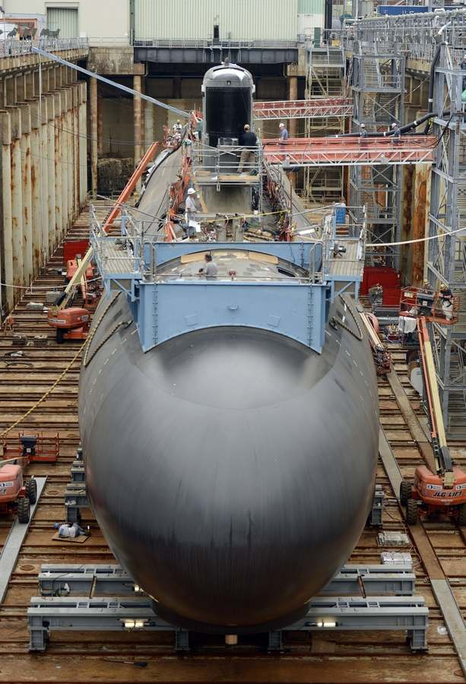
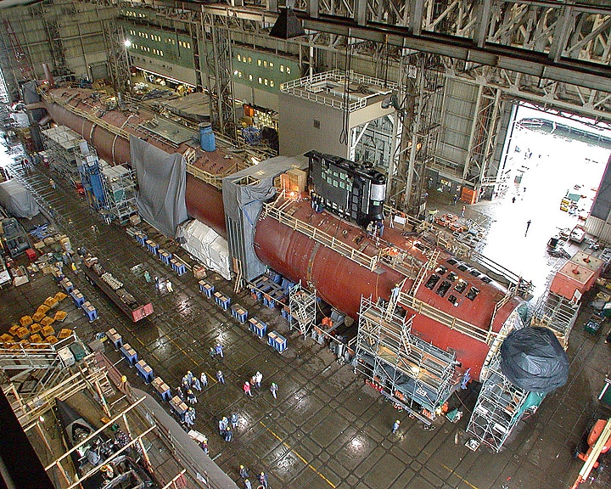
Fixed Position Example

Slide 24
Process-Oriented Layout
Like machines and equipment are grouped together
Flexible and capable of handling a wide variety of products or services
Scheduling can be difficult and setup, material handling, and labor costs can be high

Slide 25
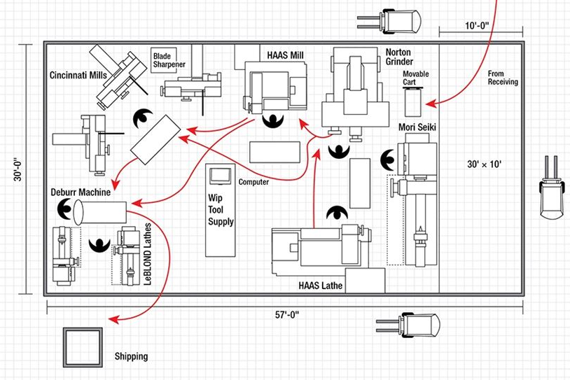
Process Layout

Slide 26
Process Layout Calculation
where n = total number of work centers or departments
i, j = individual departments
X_{ij} = number of loads moved from department i to department j
C_{ij} = cost to move a load between department i and department j

Slide 27
Process Layout Example
Room 1 Room 2 Room 3
Room 4 Room 5 Room 6
Assembly Painting Machine Shop
Department Department Department
(1) (2) (3)
Assume: 20 feet between center of each room
40'
Receiving Shipping Testing
Department Department Department
(4) (5) (6)
60'
Figure 9.5

Slide 28
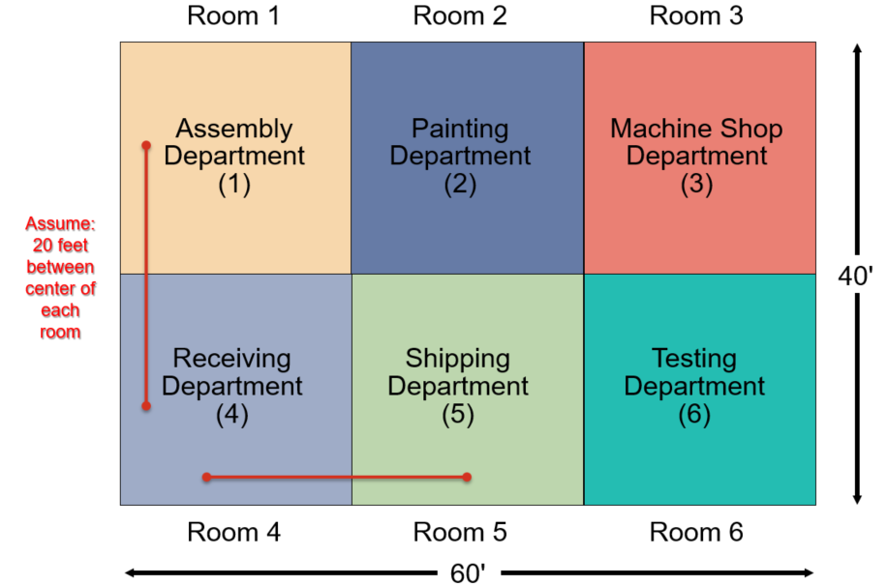
Process Layout Example
Answer the following questions for a 60 by 40 foot facility divided into 6 equal sections with the loads per week movement charts below. Assume the cost for each move is 3 dollars. Traffic never flows diagonally.
What is the optimal arrangement of rooms?
What is the expected cost?

Slide 29
Process Layout – Revised
Room 1 Room 2 Room 3
Room 4 Room 5 Room 6
Assembly Machine Shop Testing
Department Department Department
Painting Receiving Shipping
Department Department Department
Total movement = 11,460
Total cost = $34,380

Slide 30
Work Cells
Reorganizes people and machines into groups to focus on single products or product groups
Group technology identifies products that have similar characteristics for particular cells
Volume must justify cells
Cells can be reconfigured as designs or volume changes

Slide 31
Improving Layouts Using Work Cells
Material
Current layout - workers in small closed areas.
Improved layout - cross-trained workers can assist each other. May be able to add a third worker as additional output is needed.
Figure 9.9 (a)

Slide 32
Improving Layouts Using Work Cells
Current layout - straight lines make it hard to balance tasks because work may not be divided evenly
Improved layout - in U shape, workers have better access. Four cross-trained workers were reduced to three.
U-shaped line may reduce employee movement and space requirements while enhancing communication, reducing the number of workers, and facilitating inspection
Figure 9.9 (b)

Slide 33
5 Potential Work Cell Advantages
Grouped tasks leads to more frequent inspections
Fewer workers are needed
Workers can reach more of the work area
Work area can be more efficiently balanced
Communication is generally better

Slide 34
Staffing and Balancing Work Cells
Determine the Takt time
Total work time available
Takt time =
Units required to satisfy customer demand
Determine the number of operators required
Total operation time required
Takt time
Workers required =

Slide 35
Staffing Work Cells Example
60
50
40
30
20
10
0
600 mirrors per day required
Mirror production scheduled for 8 hours per day
From a work balance chart total operation time = 140 seconds
Standard time required
Assemble
Paint
Test
Label
Pack for
shipment
Figure 9.10
Operations

Slide 36
Staffing Work Cells Example
600 mirrors per day required
Mirror production scheduled for 8 hours per day
From a work balance chart operation time = 140 seconds
Takt time = Pace of production to meet customer demands
Takt time = (8 hrs x 60 mins) / 600 units
= 0.8 min = 48 seconds
Total operation time required
Takt time
Workers required =
= 140 / 48 = 2.9
= 3

Slide 37
Product-Oriented Layout
Organized around products or families of similar high-volume, low-variety products
Volume is adequate for high equipment utilization
Product demand is stable enough to justify high investment in specialized equipment
Product is standardized or approaching a phase of life cycle that justifies investment
Supplies of raw materials and components are adequate and of uniform quality

Slide 38
Product-Oriented Layouts
Advantages
Low variable cost per unit
Low material handling costs
Reduced work-in-process inventories
Easier training and supervision
Rapid throughput
Disadvantages
High volume is required
Work stoppage at any point ties up the whole operation
Lack of flexibility in product or production rates

Slide 39
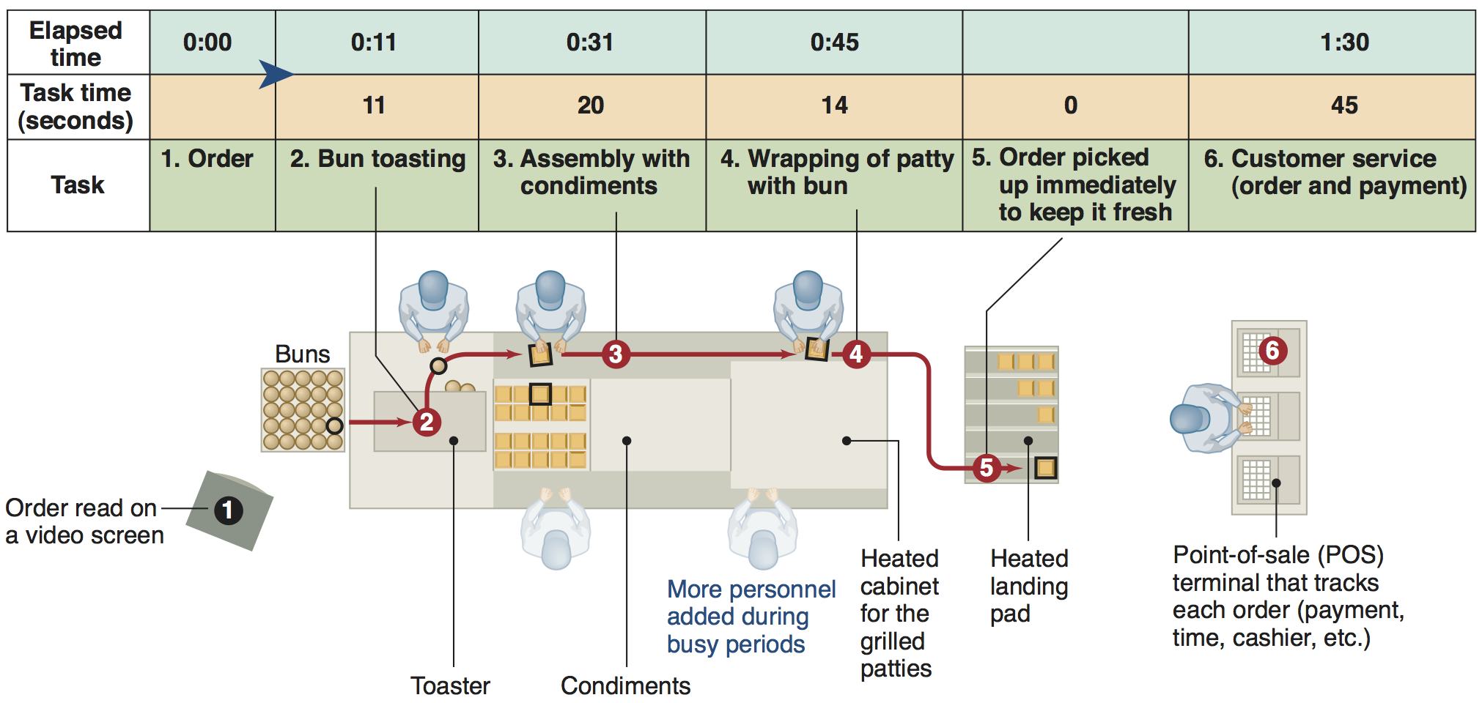
McDonald's Assembly Line
Figure 9.11

Slide 40
Assembly-Line Balancing
Objective is to minimize the imbalance between machines or personnel while meeting required output
Starts with the precedence relationships
Determine cycle time
Calculate theoretical minimum number of workstations
Balance the line by assigning specific tasks to workstations

Slide 41
Cycle Time – C_{d}
Variable | Data
Production Time | 8 hours (480 minutes)
Desired Output | 120 units
production time available
desired units of output
C_{d} =
(8 hours x 60 minutes / hour)
(120 units)
C_{d} =
480
120
C_{d} = = 4 minutes

Slide 42
Flow Time vs Cycle Time
Cycle time = max time spent at any station
1
2
3
7 minutes
3 minutes
5 minutes
Cycle time = max (7, 3, 5) = 7 minutes

Slide 43
Line Balancing Process
1. Draw and label a precedence diagram
2. Calculate the desired cycle time required for the line
3. Calculate the theoretical minimum number of workstations
4. Group elements into workstations, recognizing cycle time and precedence constraints
5. Calculate the efficiency of the line
6. Stop if…
Theoretical minimum number of workstations
OR
Acceptable efficiency level reached
If not, go back to step 4

Slide 44
Wing Component Example
TABLE 9.2 |  | Precedence Data for Wing Component
TASK | ASSEMBLY TIME (MINUTES) |  |  |  | TASK MUST FOLLOW TASK LISTED BELOW
A |  |  | 10 |  | –
B |  |  | 11 |  | A
C |  |  | 5 |  | B
D |  |  | 4 |  | B
E |  |  | 11 |  | A
F |  |  | 3 |  | C, D
G |  |  | 7 |  | F
H |  |  | 11 |  | E
I |  |  | 3 |  | G, H
Total time |  |  | 65
480 available mins per day
40 units required

Slide 45
Wing Component Example
TABLE 9.2 |  | Precedence Data for Wing Component
TASK | ASSEMBLY TIME (MINUTES) |  |  |  | TASK MUST FOLLOW TASK LISTED BELOW: PREDECESSOR
A |  |  | 10 |  | –
B |  |  | 11 |  | A
C |  |  | 5 |  | B
D |  |  | 4 |  | B
E |  |  | 11 |  | A
F |  |  | 3 |  | C, D
G |  |  | 7 |  | F
H |  |  | 11 |  | E
I |  |  | 3 |  | G, H
Total time |  |  | 65
This means that tasks B and E cannot be done until task A has been completed

Slide 46
Complete the Diagram
TABLE 9.2 |  | Precedence Data
TASK | TIME (MINUTES) |  |  |  | Predecessor
A |  |  | 10 |  | –
B |  |  | 11 |  | A
C |  |  | 5 |  | B
D |  |  | 4 |  | B
E |  |  | 11 |  | A
F |  |  | 3 |  | C, D
G |  |  | 7 |  | F
H |  |  | 11 |  | E
I |  |  | 3 |  | G, H
A
10
D
4
G
7
B
11
E
11
H
11
C
5
F
3
I
3

Slide 47
Wing Component Example
TABLE 9.2 |  | Precedence Data for Wing Component
TASK | ASSEMBLY TIME (MINUTES) |  |  |  | PEDECESSOR
A |  |  | 10 |  | –
B |  |  | 11 |  | A
C |  |  | 5 |  | B
D |  |  | 4 |  | B
E |  |  | 11 |  | A
F |  |  | 3 |  | C, D
G |  |  | 7 |  | F
H |  |  | 11 |  | E
I |  |  | 3 |  | G, H
Total time |  |  | 65
480 available mins per day
40 units required
5
C
10
11
3
7
A
B
F
G
4
3
11
D
11
I
E
H
Figure 9.12

Slide 48
Wing Component Example
TABLE 9.2 |  | Precedence Data for Wing Component
TASK | ASSEMBLY TIME (MINUTES) |  |  |  | PREDECESSOR
A |  |  | 10 |  | –
B |  |  | 11 |  | A
C |  |  | 5 |  | B
D |  |  | 4 |  | B
E |  |  | 11 |  | A
F |  |  | 3 |  | C, D
G |  |  | 7 |  | F
H |  |  | 11 |  | E
I |  |  | 3 |  | G, H
Total time |  |  | 65
Cycle time =
Production time available per day
Units required per day
Minimum number of workstations
480 available mins per day
40 units required

Slide 49
Wing Component Example
TABLE 9.2 |  | Precedence Data for Wing Component
TASK | ASSEMBLY TIME (MINUTES) |  |  |  | PREDECESSOR
A |  |  | 10 |  | –
B |  |  | 11 |  | A
C |  |  | 5 |  | B
D |  |  | 4 |  | B
E |  |  | 11 |  | A
F |  |  | 3 |  | C, D
G |  |  | 7 |  | F
H |  |  | 11 |  | E
I |  |  | 3 |  | G, H
Total time |  |  | 65
Cycle time =
Production time available per day
Units required per day
480 available mins per day
40 units required

Slide 50
Wing Component Example
TABLE 9.2 |  | Precedence Data for Wing Component
TASK | ASSEMBLY TIME (MINUTES) |  |  |  | PREDECESSOR
A |  |  | 10 |  | –
B |  |  | 11 |  | A
C |  |  | 5 |  | B
D |  |  | 4 |  | B
E |  |  | 11 |  | A
F |  |  | 3 |  | C, D
G |  |  | 7 |  | F
H |  |  | 11 |  | E
I |  |  | 3 |  | G, H
Total time |  |  | 65
Cycle time =
Production time available per day
Units required per day
= 480 / 40
480 available mins per day
40 units required

Slide 51
Wing Component Example
TABLE 9.2 |  | Precedence Data for Wing Component
TASK | ASSEMBLY TIME (MINUTES) |  |  |  | PREDECESSOR
A |  |  | 10 |  | –
B |  |  | 11 |  | A
C |  |  | 5 |  | B
D |  |  | 4 |  | B
E |  |  | 11 |  | A
F |  |  | 3 |  | C, D
G |  |  | 7 |  | F
H |  |  | 11 |  | E
I |  |  | 3 |  | G, H
Total time |  |  | 65
Cycle time =
Production time available per day
Units required per day
= 480 / 40
= 12 minutes per unit
480 available mins per day
40 units required

Slide 52
Wing Component Example
TABLE 9.2 |  | Precedence Data for Wing Component
TASK | ASSEMBLY TIME (MINUTES) |  |  |  | PREDECESSOR
A |  |  | 10 |  | –
B |  |  | 11 |  | A
C |  |  | 5 |  | B
D |  |  | 4 |  | B
E |  |  | 11 |  | A
F |  |  | 3 |  | C, D
G |  |  | 7 |  | F
H |  |  | 11 |  | E
I |  |  | 3 |  | G, H
Total time |  |  | 65
Cycle time =
Production time available per day
Units required per day
= 480 / 40
= 12 minutes per unit
480 available mins per day
40 units required
Minimum number of workstations

Slide 53
Wing Component Example
TABLE 9.2 |  | Precedence Data for Wing Component
TASK | ASSEMBLY TIME (MINUTES) |  |  |  | PREDECESSOR
A |  |  | 10 |  | –
B |  |  | 11 |  | A
C |  |  | 5 |  | B
D |  |  | 4 |  | B
E |  |  | 11 |  | A
F |  |  | 3 |  | C, D
G |  |  | 7 |  | F
H |  |  | 11 |  | E
I |  |  | 3 |  | G, H
Total time |  |  | 65
Cycle time =
Production time available per day
Units required per day
= 480 / 40
= 12 minutes per unit
480 available mins per day
40 units required
Minimum number of workstations
= 65 / 12

Slide 54
Wing Component Example
TABLE 9.2 |  | Precedence Data for Wing Component
TASK | ASSEMBLY TIME (MINUTES) |  |  |  | PREDECESSOR
A |  |  | 10 |  | –
B |  |  | 11 |  | A
C |  |  | 5 |  | B
D |  |  | 4 |  | B
E |  |  | 11 |  | A
F |  |  | 3 |  | C, D
G |  |  | 7 |  | F
H |  |  | 11 |  | E
I |  |  | 3 |  | G, H
Total time |  |  | 65
Cycle time =
Production time available per day
Units required per day
= 480 / 40
= 12 minutes per unit
480 available mins per day
40 units required
Minimum number of workstations
= 65 / 12
= 5.4

Slide 55
Wing Component Example
TABLE 9.2 |  | Precedence Data for Wing Component
TASK | ASSEMBLY TIME (MINUTES) |  |  |  | PREDECESSOR
A |  |  | 10 |  | –
B |  |  | 11 |  | A
C |  |  | 5 |  | B
D |  |  | 4 |  | B
E |  |  | 11 |  | A
F |  |  | 3 |  | C, D
G |  |  | 7 |  | F
H |  |  | 11 |  | E
I |  |  | 3 |  | G, H
Total time |  |  | 65
Cycle time =
Production time available per day
Units required per day
= 480 / 40
= 12 minutes per unit
480 available mins per day
40 units required
Minimum number of workstations
= 65 / 12
= 5.4
= 6 stations

Slide 56
Rules for Assigning Workstations
TABLE 9.3 | Layout Heuristics That May Be Used to Assign Tasks to Workstations in Assembly-Line Balancing
1. Longest task time |  | From the available tasks, choose the task with the largest (longest) task time
2. Most following tasks |  | From the available tasks, choose the task with the largest number of following tasks
3. Ranked positional weight |  | From the available tasks, choose the task for which the sum of following task times is the longest
4. Shortest task time |  | From the available tasks, choose the task with the shortest task time
5. Least number of following tasks |  | From the available tasks, choose the task with the least number of subsequent tasks

Slide 57
Assign the Workstations
Station 2
480 available mins per day
40 units required
Cycle time = 12 mins
Minimum workstations
= 6
Station 3
Station 3
Station 4
5
Station 6
Station 6
C
10
11
3
7
Station 5
A
B
F
G
4
3
D
I
11
11
E
H
Station 1

Slide 58
Wing Component Example
480 available mins per day
40 units required
Cycle time = 12 mins
= 6
Minimum workstations
Station 2
5
C
10
11
3
7
A
B
F
G
4
3
D
Station 3
I
Station 5
11
11
Station 6
Station 1
E
H
Station 6
Station 3
Station 4

Slide 59
Wing Component Example
TABLE 9.2 |  | Precedence Data for Wing Component
TASK | ASSEMBLY TIME (MINUTES) |  |  |  | PREDECESSOR
A |  |  | 10 |  | –
B |  |  | 11 |  | A
C |  |  | 5 |  | B
D |  |  | 4 |  | B
E |  |  | 11 |  | A
F |  |  | 3 |  | C, D
G |  |  | 7 |  | F
H |  |  | 11 |  | E
I |  |  | 3 |  | G, H
Total time |  |  | 65
480 available mins per day
40 units required
Cycle time:
12 minutes per unit
Min workstations:
6 stations
∑ Task times
(Actual number of workstations) x (Largest cycle time)
Efficiency =

Slide 60
Wing Component Example
TABLE 9.2 |  | Precedence Data for Wing Component
TASK | ASSEMBLY TIME (MINUTES) |  |  |  | PREDECESSOR
A |  |  | 10 |  | –
B |  |  | 11 |  | A
C |  |  | 5 |  | B
D |  |  | 4 |  | B
E |  |  | 11 |  | A
F |  |  | 3 |  | C, D
G |  |  | 7 |  | F
H |  |  | 11 |  | E
I |  |  | 3 |  | G, H
Total time |  |  | 65
480 available mins per day
40 units required
Cycle time:
12 minutes per unit
Min workstations:
6 stations
∑ Task times
(Actual number of workstations) x (Largest cycle time)
Efficiency =
= 65 minutes

Slide 61
Wing Component Example
TABLE 9.2 |  | Precedence Data for Wing Component
TASK | ASSEMBLY TIME (MINUTES) |  |  |  | PREDECESSOR
A |  |  | 10 |  | –
B |  |  | 11 |  | A
C |  |  | 5 |  | B
D |  |  | 4 |  | B
E |  |  | 11 |  | A
F |  |  | 3 |  | C, D
G |  |  | 7 |  | F
H |  |  | 11 |  | E
I |  |  | 3 |  | G, H
Total time |  |  | 65
480 available mins per day
40 units required
Cycle time:
12 minutes per unit
Min workstations:
6 stations
∑ Task times
(Actual number of workstations) x (Largest cycle time)
Efficiency =
= 65 minutes / ((6 stations)

Slide 62
Wing Component Example
TABLE 9.2 |  | Precedence Data for Wing Component
TASK | ASSEMBLY TIME (MINUTES) |  |  |  | PREDECESSOR
A |  |  | 10 |  | –
B |  |  | 11 |  | A
C |  |  | 5 |  | B
D |  |  | 4 |  | B
E |  |  | 11 |  | A
F |  |  | 3 |  | C, D
G |  |  | 7 |  | F
H |  |  | 11 |  | E
I |  |  | 3 |  | G, H
Total time |  |  | 65
480 available mins per day
40 units required
Cycle time:
12 minutes per unit
Min workstations:
6 stations
∑ Task times
(Actual number of workstations) x (Largest cycle time)
Efficiency =
= 65 minutes / ((6 stations) x (12 minutes))

Slide 63
Wing Component Example
TABLE 9.2 |  | Precedence Data for Wing Component
TASK | ASSEMBLY TIME (MINUTES) |  |  |  | PREDECESSOR
A |  |  | 10 |  | –
B |  |  | 11 |  | A
C |  |  | 5 |  | B
D |  |  | 4 |  | B
E |  |  | 11 |  | A
F |  |  | 3 |  | C, D
G |  |  | 7 |  | F
H |  |  | 11 |  | E
I |  |  | 3 |  | G, H
Total time |  |  | 65
480 available mins per day
40 units required
Cycle time:
12 minutes per unit
Min workstations:
6 stations
∑ Task times
(Actual number of workstations) x (Largest cycle time)
Efficiency =
= 65 minutes / ((6 stations) x (12 minutes))
= 90%

Slide 64
Wing Component Example
TABLE 9.2 |  | Precedence Data for Wing Component
TASK | ASSEMBLY TIME (MINUTES) |  |  |  | PREDECESSOR
A |  |  | 10 |  | –
B |  |  | 11 |  | A
C |  |  | 5 |  | B
D |  |  | 4 |  | B
E |  |  | 11 |  | A
F |  |  | 3 |  | C, D
G |  |  | 7 |  | F
H |  |  | 11 |  | E
I |  |  | 3 |  | G, H
Total time |  |  | 65
480 available mins per day
40 units required
Cycle time:
12 minutes per unit
Min workstations:
6 stations
Efficiency:
90%
Idle Time =
(Actual number of workstations x Largest assigned cycle time) - ∑ Task times

Slide 65
Wing Component Example
TABLE 9.2 |  | Precedence Data for Wing Component
TASK | ASSEMBLY TIME (MINUTES) |  |  |  | PREDECESSOR
A |  |  | 10 |  | –
B |  |  | 11 |  | A
C |  |  | 5 |  | B
D |  |  | 4 |  | B
E |  |  | 11 |  | A
F |  |  | 3 |  | C, D
G |  |  | 7 |  | F
H |  |  | 11 |  | E
I |  |  | 3 |  | G, H
Total time |  |  | 65
480 available mins per day
40 units required
Cycle time:
12 minutes per unit
Min workstations:
6 stations
Efficiency:
90%
Idle Time = ((6 stations) × (12 minutes)) – 65 minutes
= 72 - ∑ Task times

Slide 66
Wing Component Example
TABLE 9.2 |  | Precedence Data for Wing Component
TASK | ASSEMBLY TIME (MINUTES) |  |  |  | PREDECESSOR
A |  |  | 10 |  | –
B |  |  | 11 |  | A
C |  |  | 5 |  | B
D |  |  | 4 |  | B
E |  |  | 11 |  | A
F |  |  | 3 |  | C, D
G |  |  | 7 |  | F
H |  |  | 11 |  | E
I |  |  | 3 |  | G, H
Total time |  |  | 65
480 available mins per day
40 units required
Cycle time:
12 minutes per unit
Min workstations:
6 stations
Efficiency:
90%
Idle Time = ((6 stations) × (12 minutes)) – 65 minutes
= 72 - ∑ Task times
= 7 minutes

Slide 67
Wing Component Example
TABLE 9.2 |  | Precedence Data for Wing Component
TASK | ASSEMBLY TIME (MINUTES) |  |  |  | PREDECESSOR
A |  |  | 10 |  | –
B |  |  | 11 |  | A
C |  |  | 5 |  | B
D |  |  | 4 |  | B
E |  |  | 11 |  | A
F |  |  | 3 |  | C, D
G |  |  | 7 |  | F
H |  |  | 11 |  | E
I |  |  | 3 |  | G, H
Total time |  |  | 65
Cycle time:
12 minutes per unit
Efficiency:
90%
Min workstations:
6 stations
Idle Time:
7 minutes
480 available mins per day
40 units required

Slide 68
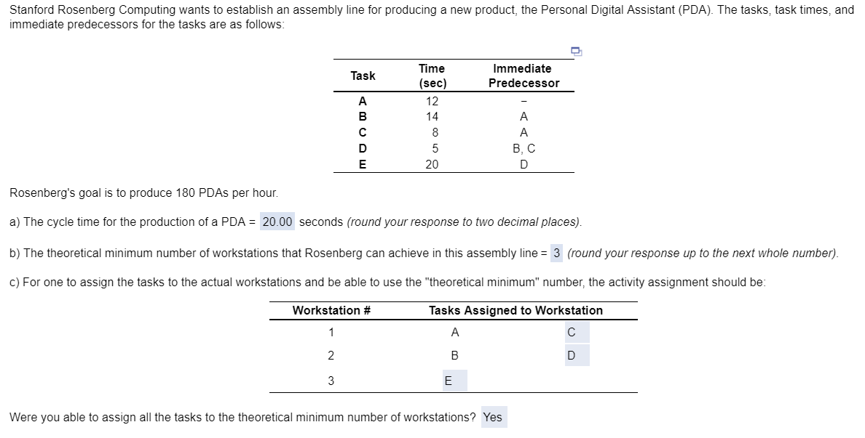
Sample HW Problem

Slide 69
Sample HW Problem – Solution

Slide 70
Self Assessment
Draw a rough diagram of the layout of your favorite store
Using the ideas from this class, discuss good and bad layout strategies
Consider a warehouse for a company selling computers and computer supplies (Staples or Office Depot)
How would you organize this warehouse to optimize the layout?

Slide 71
Supplemental

Slide 72
Layouts
A company hired your operations management consulting firm to improve the layouts of their offices, store, and warehouse.
How would you do this and what general Operations Management fundamentals should be considered?

Slide 73
Office Layout
Grouping of workers, their equipment, and spaces
Provide comfort, safety, and movement of information
Movement of information is main distinction
Can change due to technological changes
Cubicles vs. Open desks

Slide 74

Office Layout
Physical, political, and social aspects
Proximity
Privacy
Seniority
Two major trends
Information technology
Dynamic needs for space and services

Slide 75
5 Ideas for Supermarket Layout
Locate high-draw items around the periphery of the store
Use prominent locations for high-impulse and high-margin items
Distribute power items to both sides of an aisle and disperse them to increase viewing of other items
Use end-aisle locations
Convey mission of store through careful positioning of lead-off department

Slide 76
Warehouse and Storage Layouts
Material Handling Costs
All costs associated with the transaction
Incoming transport
Storage
Finding and moving material
Outgoing transport
Equipment, people, material, supervision, insurance, depreciation
Minimize damage and spoilage

Slide 77
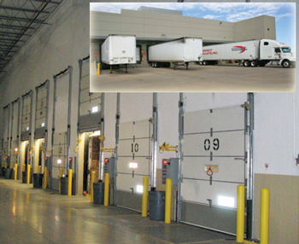
Warehouse and Storage Layouts
Warehouse density tends to vary inversely with the number of different items stored
Automated Storage and Retrieval Systems (ASRSs) can significantly improve warehouse productivity
Dock location is a key design element
One way in
One way out

Slide 78
Process-Oriented Layout
Arrange work centers so as to minimize the costs of material handling
Basic cost elements are
Number of loads (or people) moving between centers
Distance loads (or people) move between centers

Slide 79
Process-Oriented Layout
Surgery
ER triage room
Emergency room admissions
Patient A - broken leg
Patient B - erratic heart pacemaker
Laboratories
Radiology
ER Beds
Pharmacy
Billing/exit
Figure 9.3

